Slide 1
Student support services/TRiO graduation banquet
May 1, 2015

Slide 2
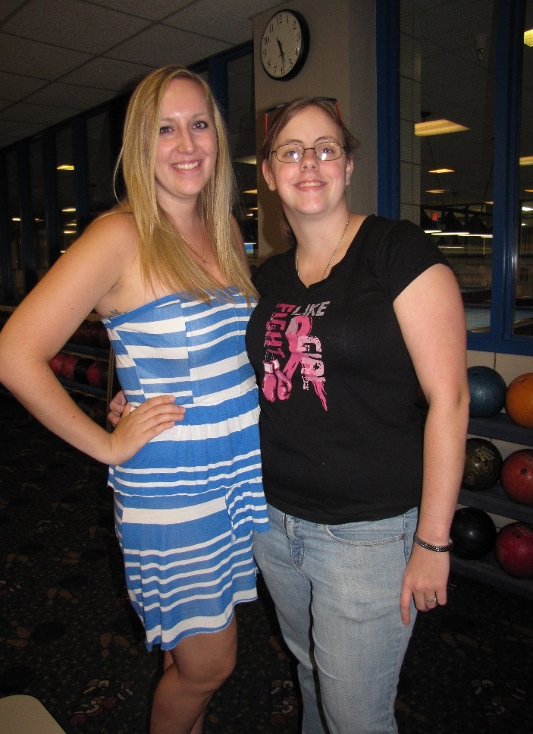
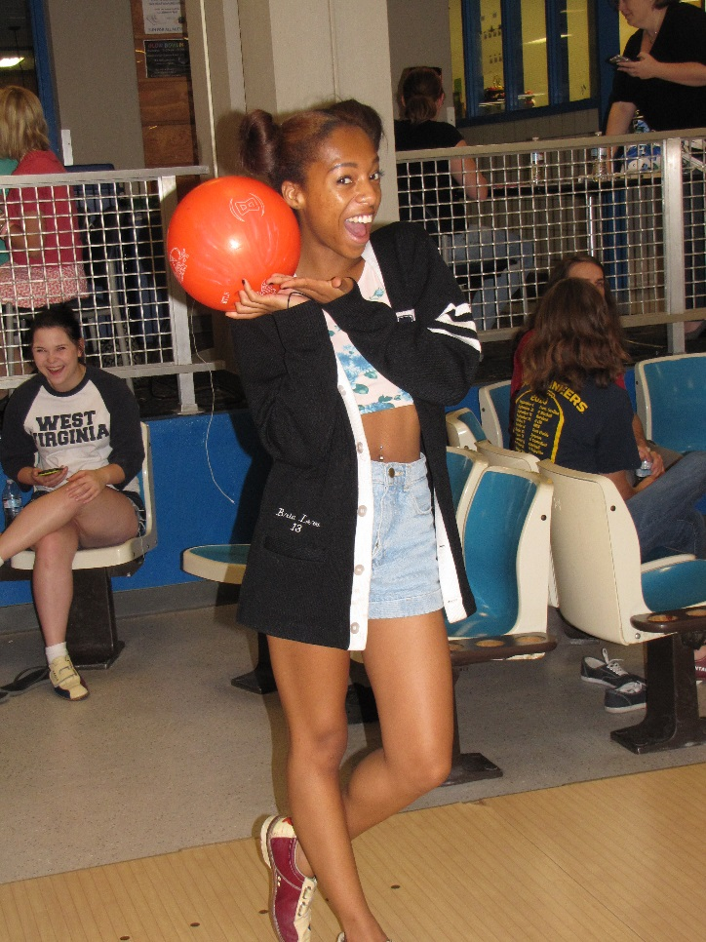
Welcome back students!

Slide 3
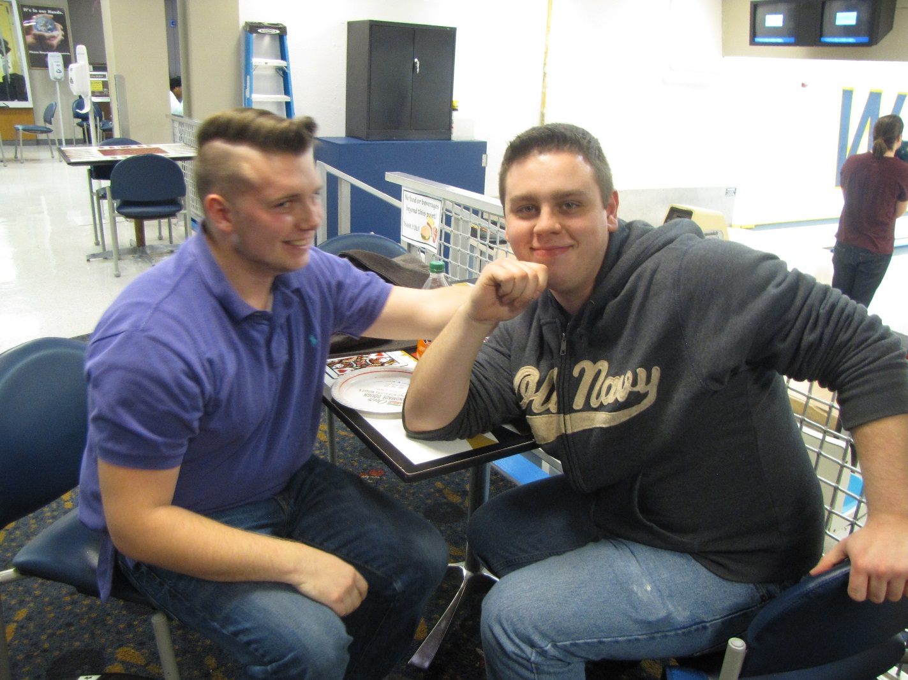
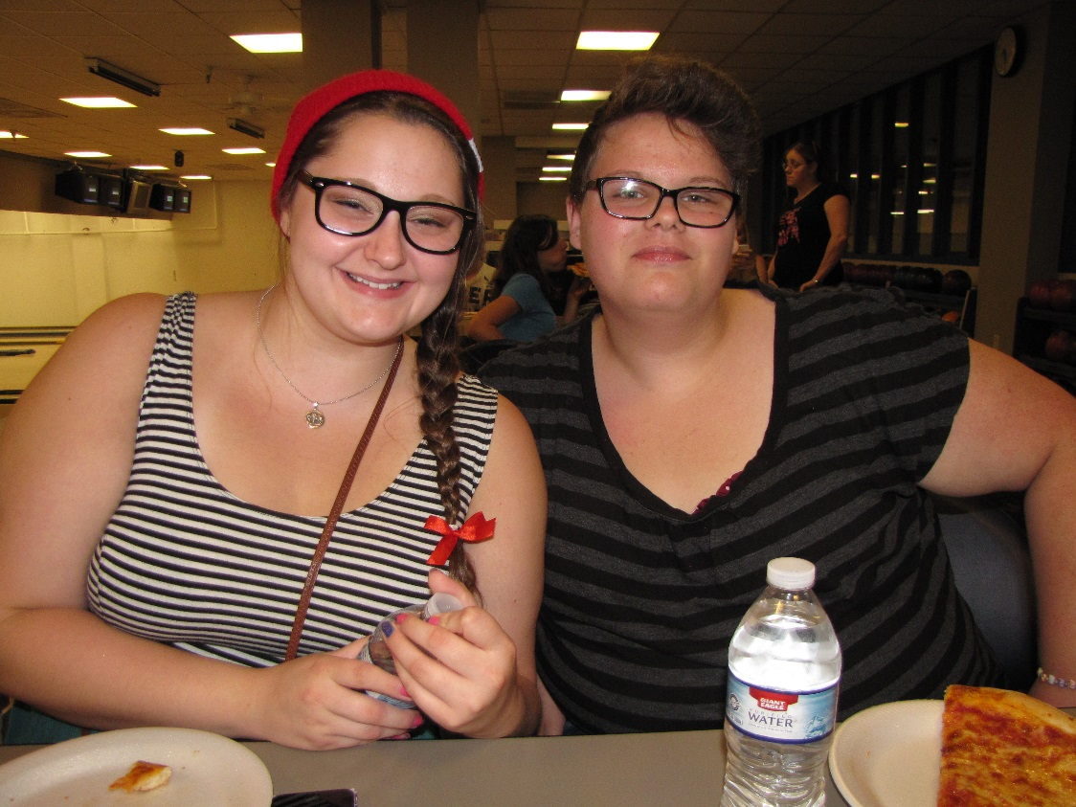

Slide 4
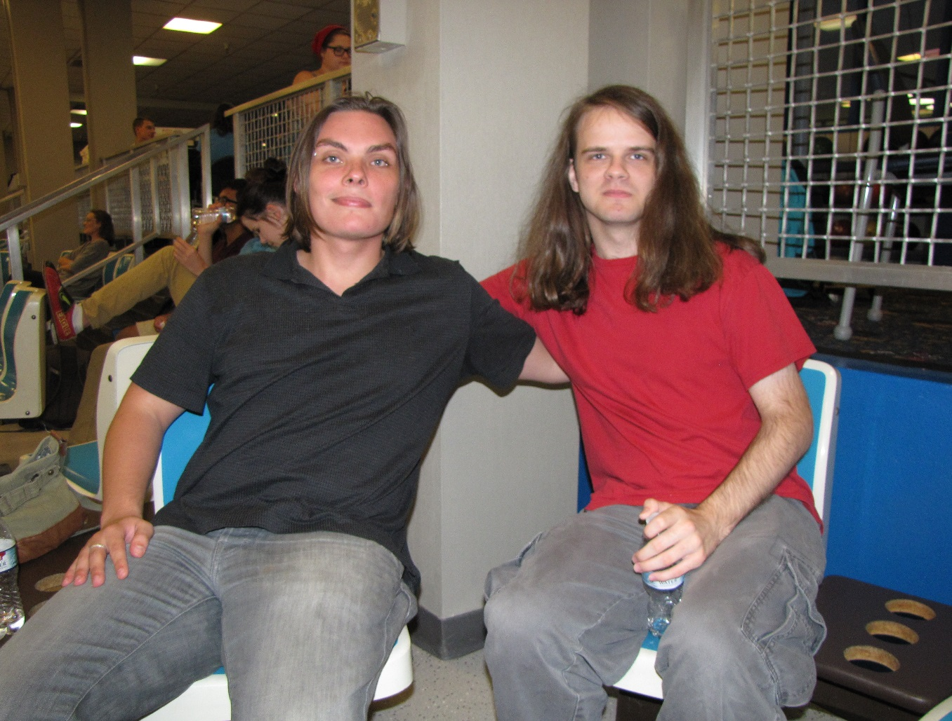
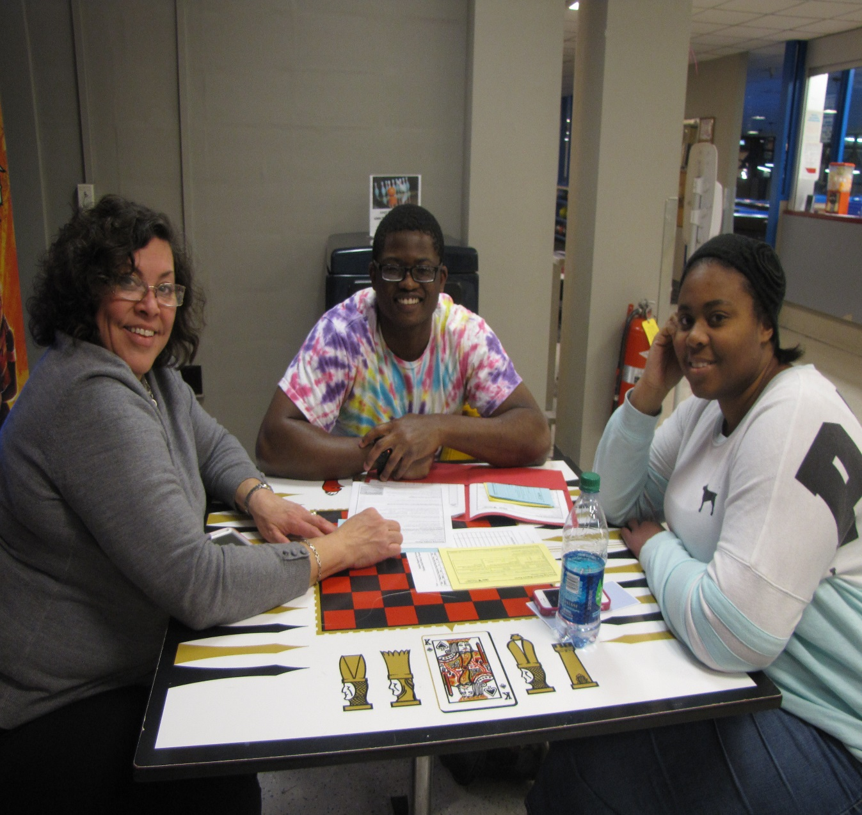

Slide 5
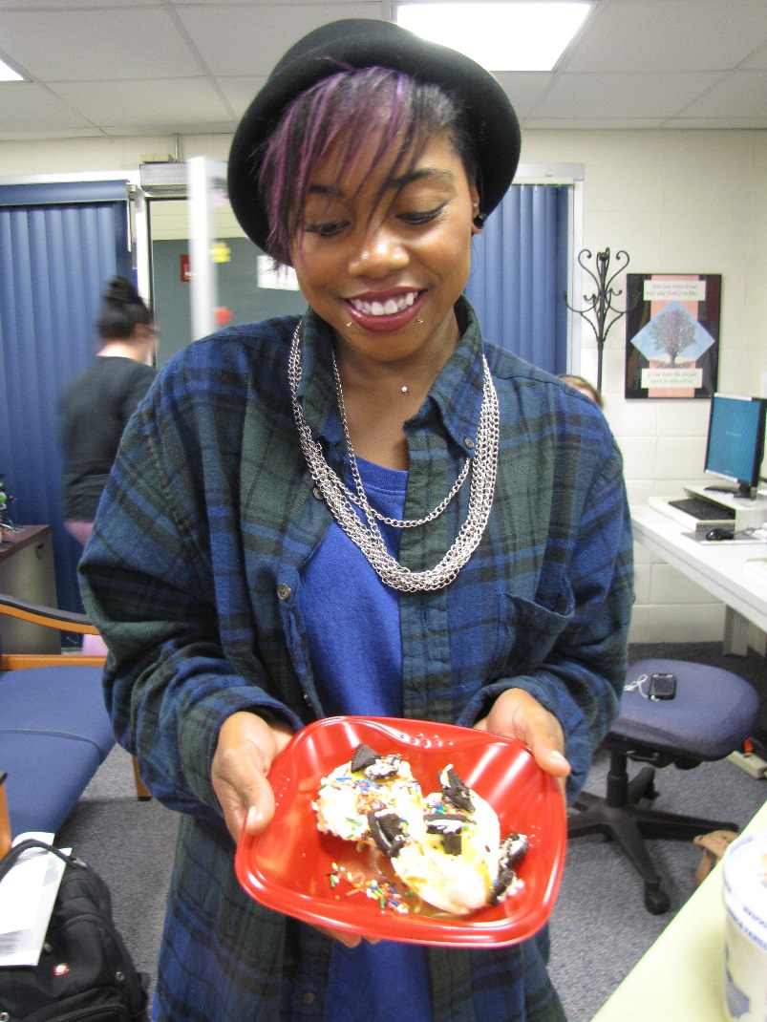
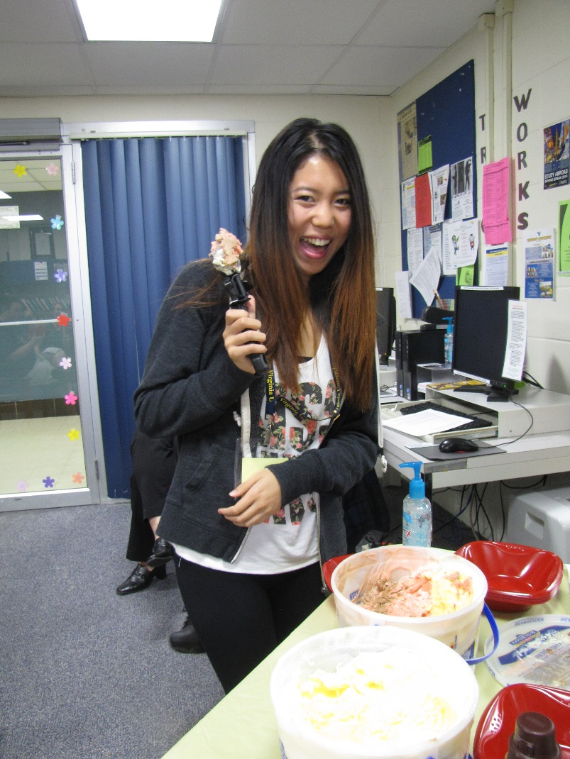
Build your own sundae

Slide 6
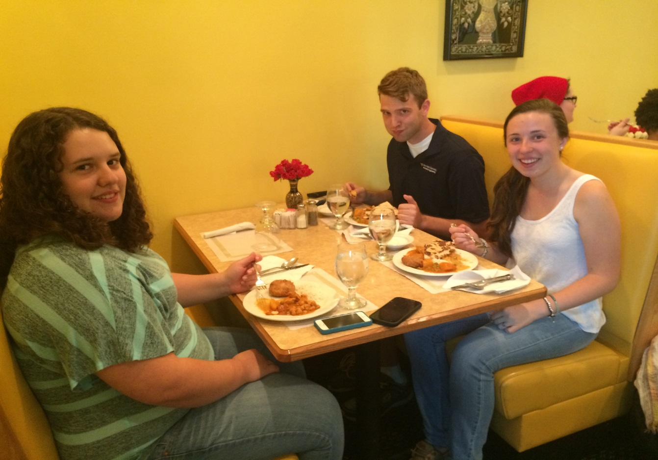
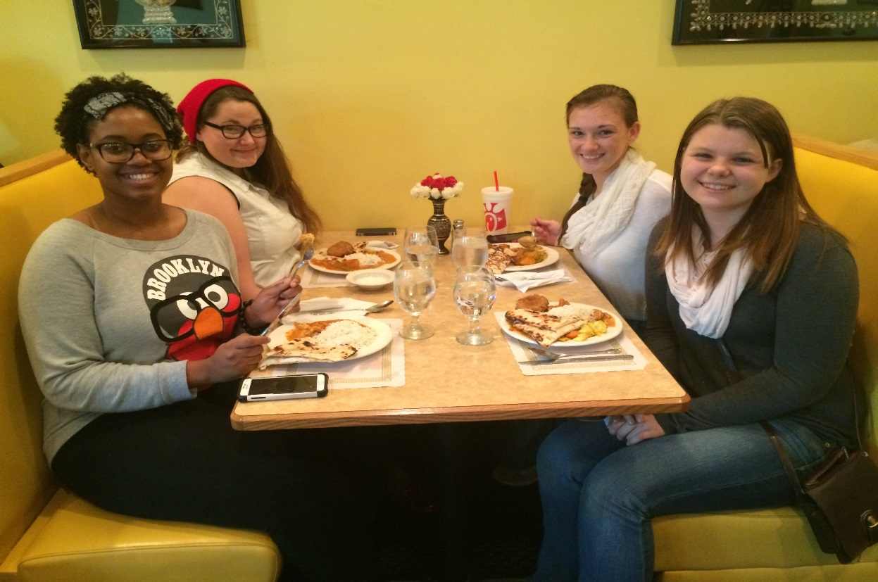
Cultural Dinner
Mother of India

Slide 7
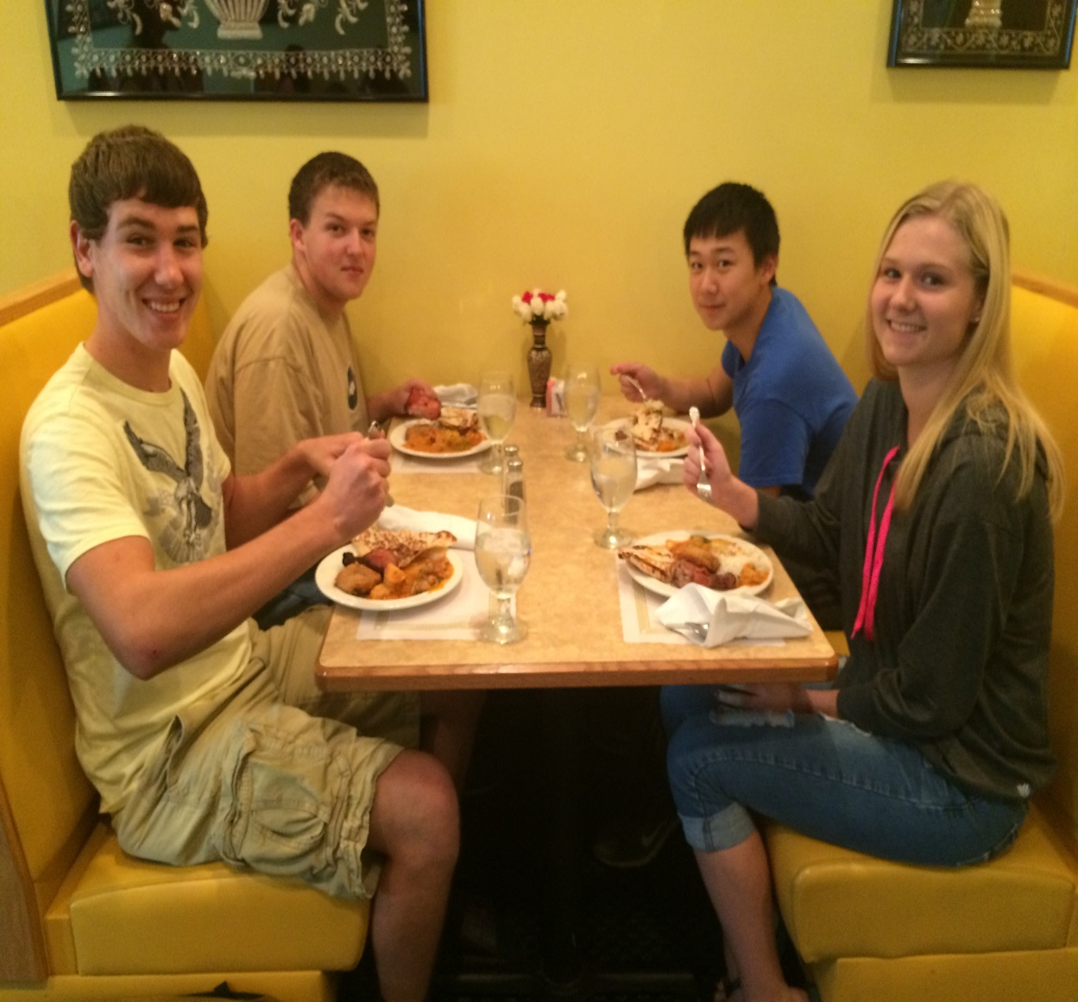
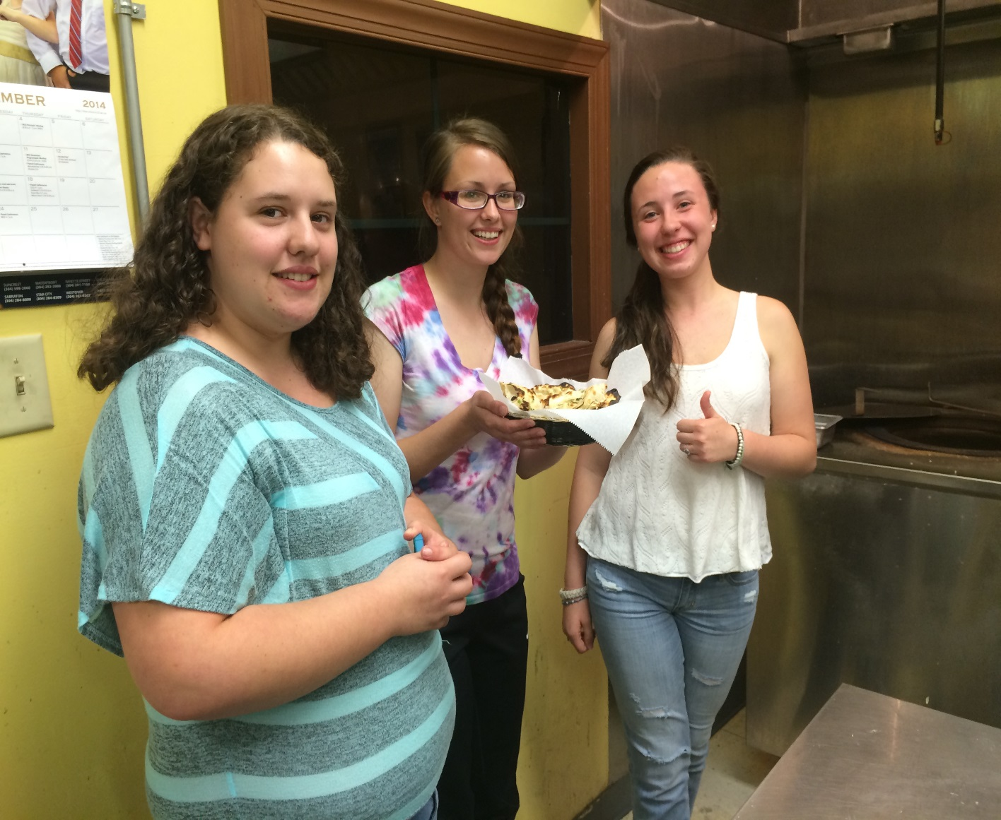

Slide 8
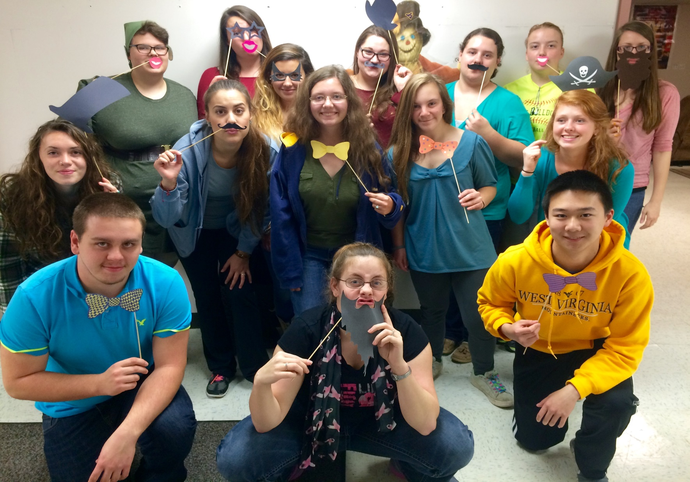
Autumn Fest

Slide 9
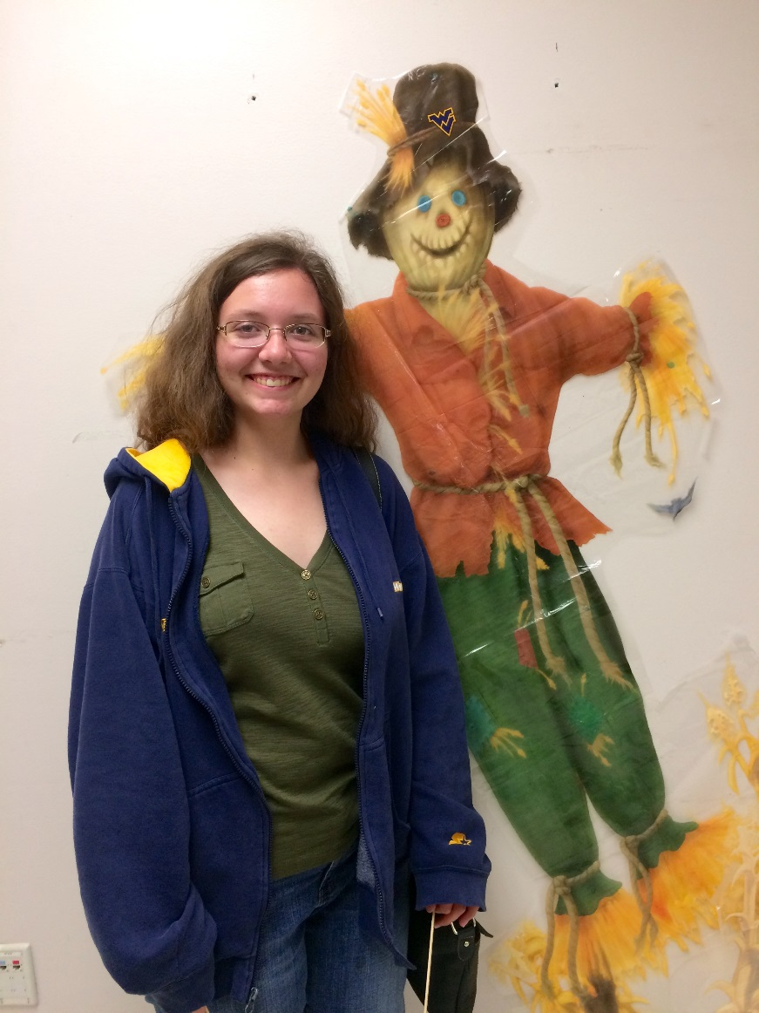
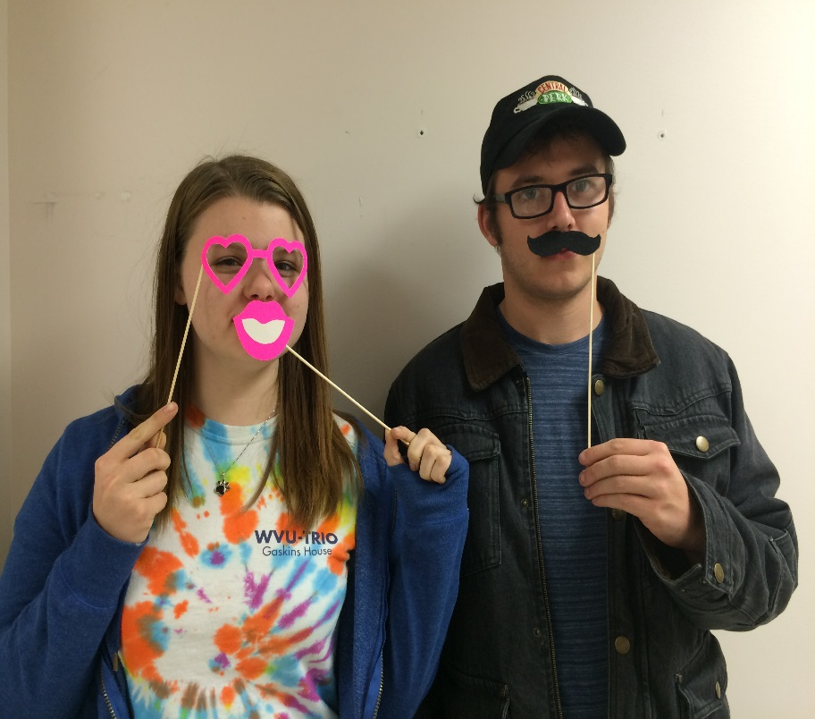
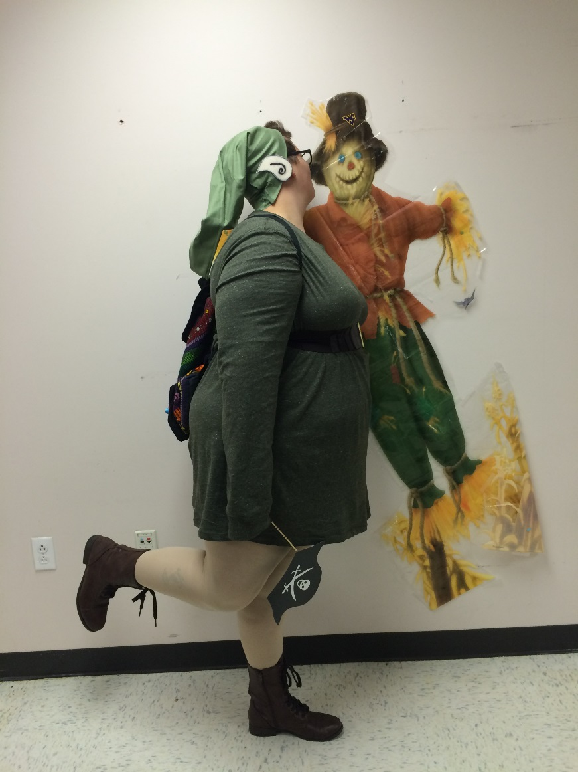

Slide 10
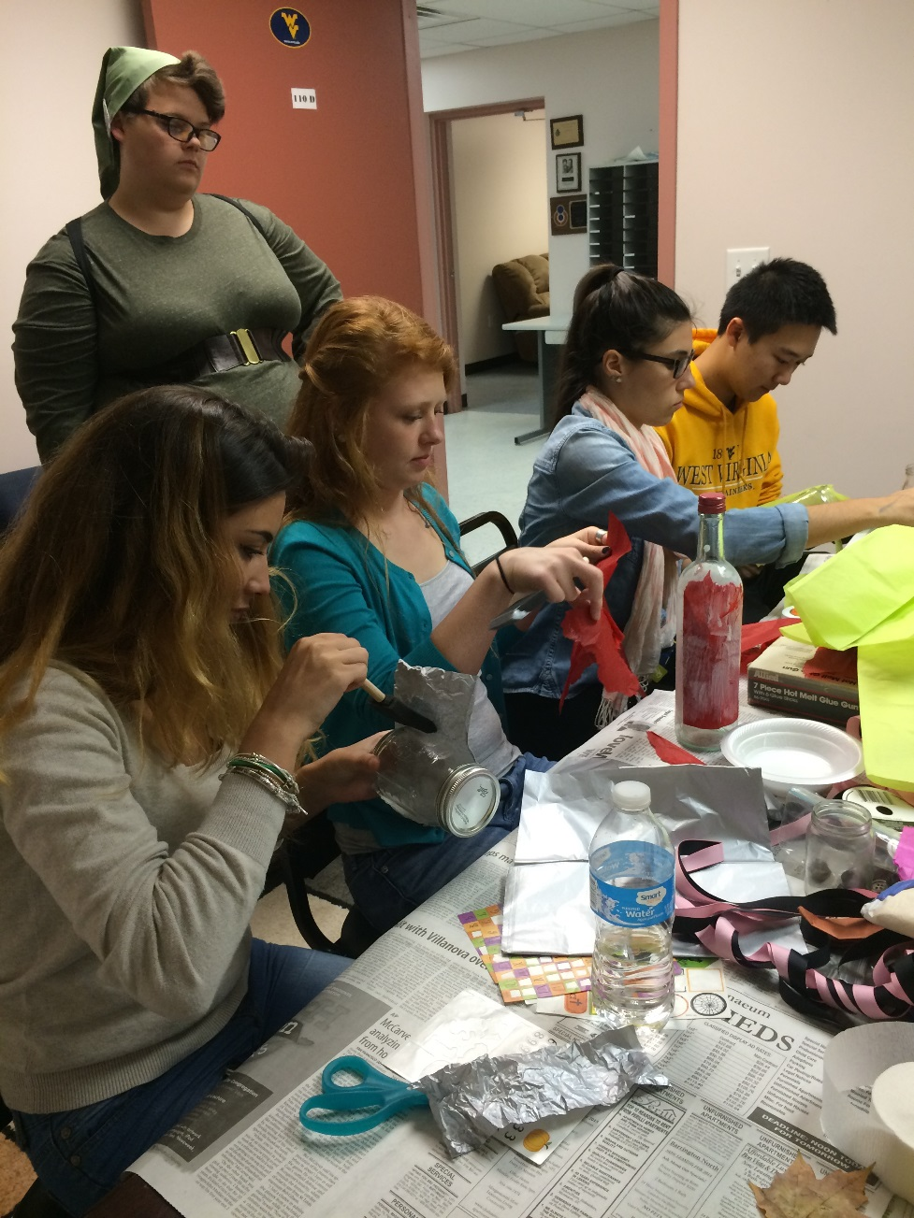
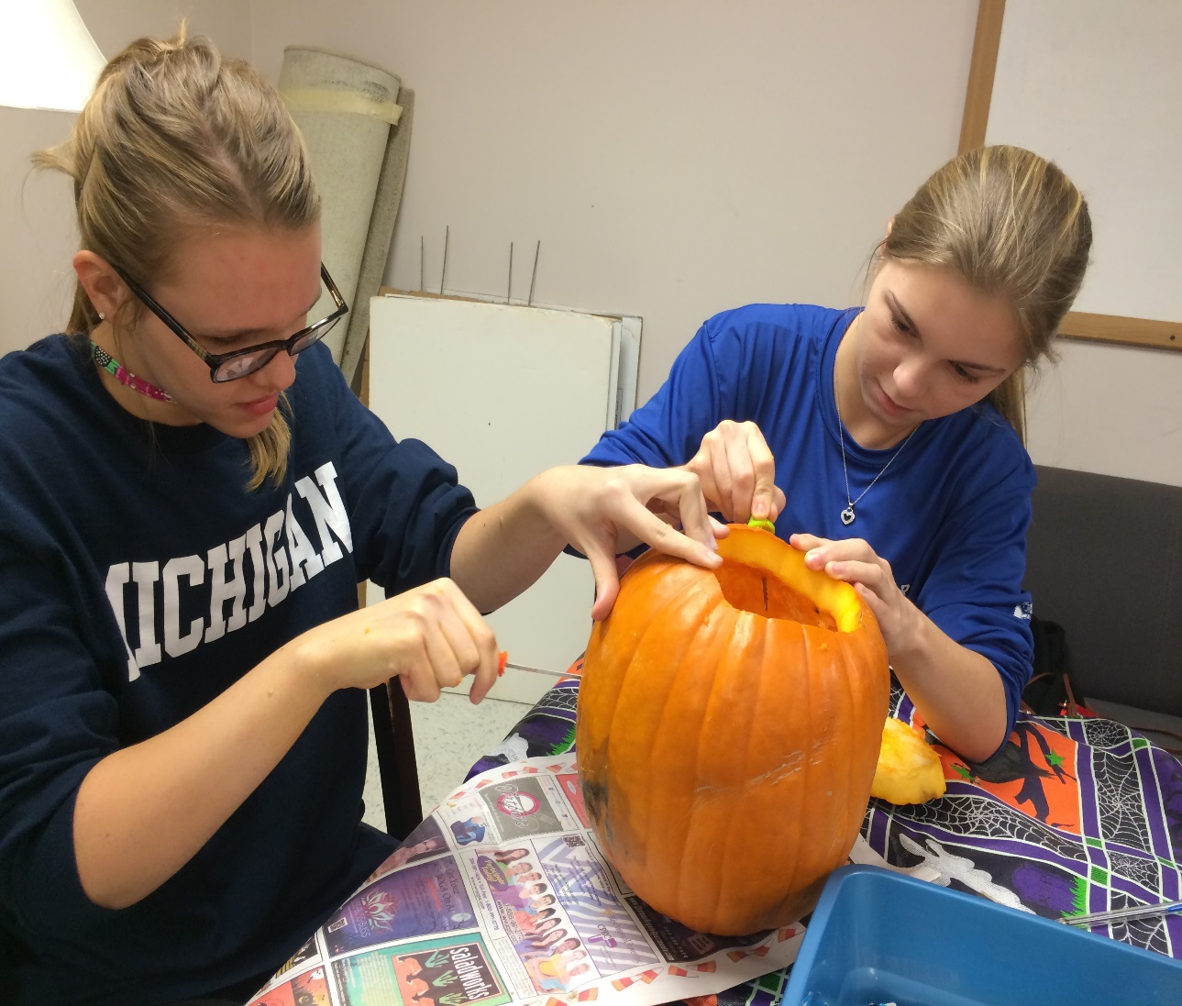
Crafts!

Slide 11
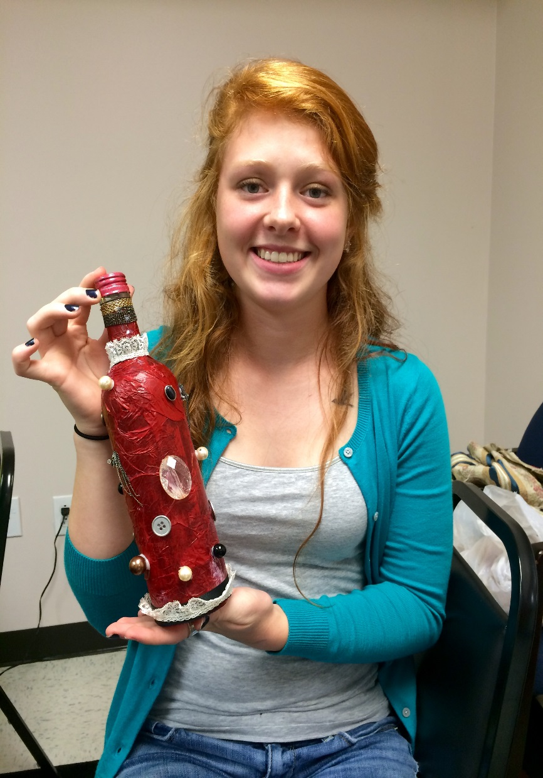
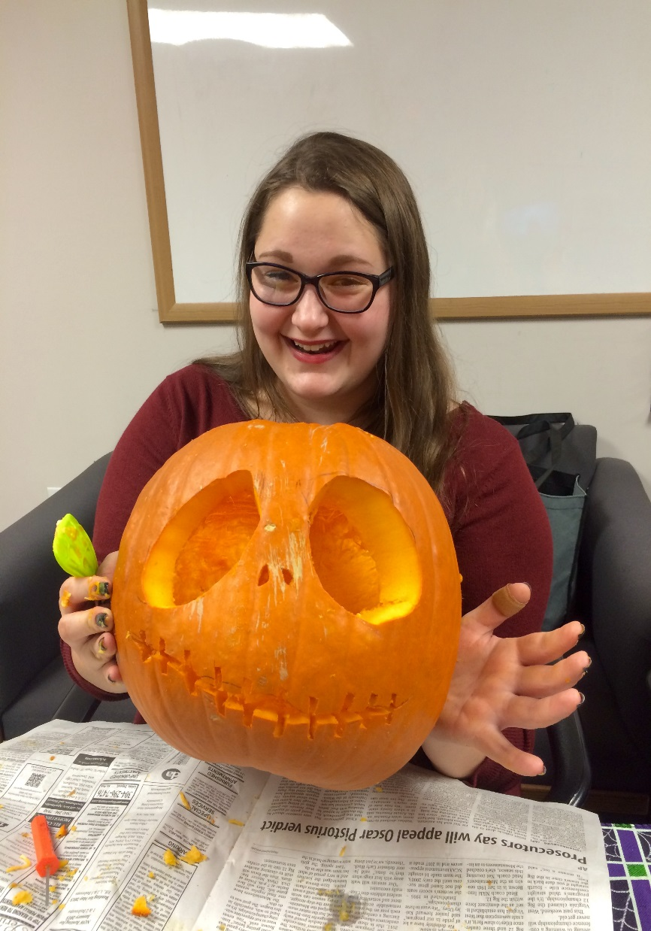
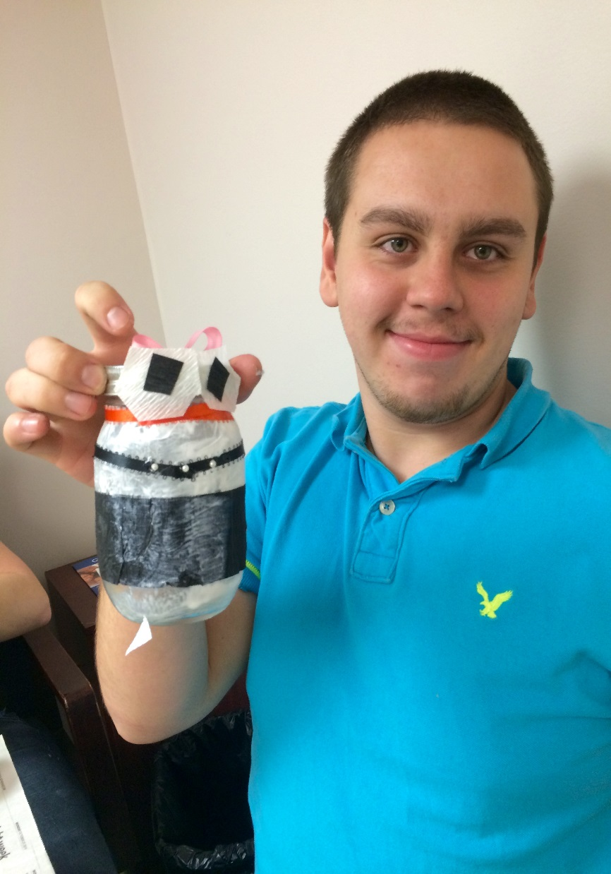

Slide 12
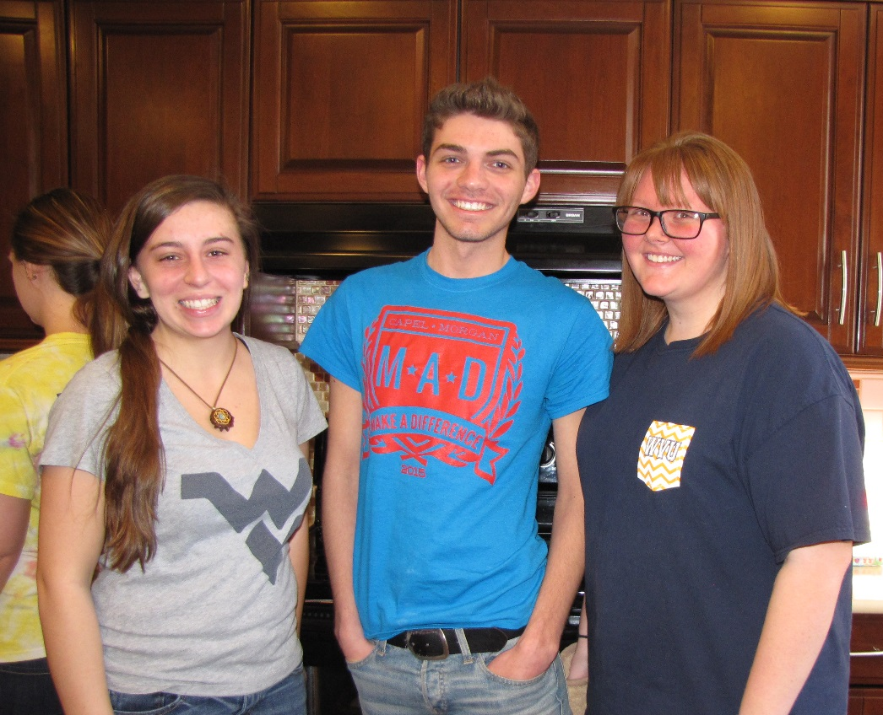
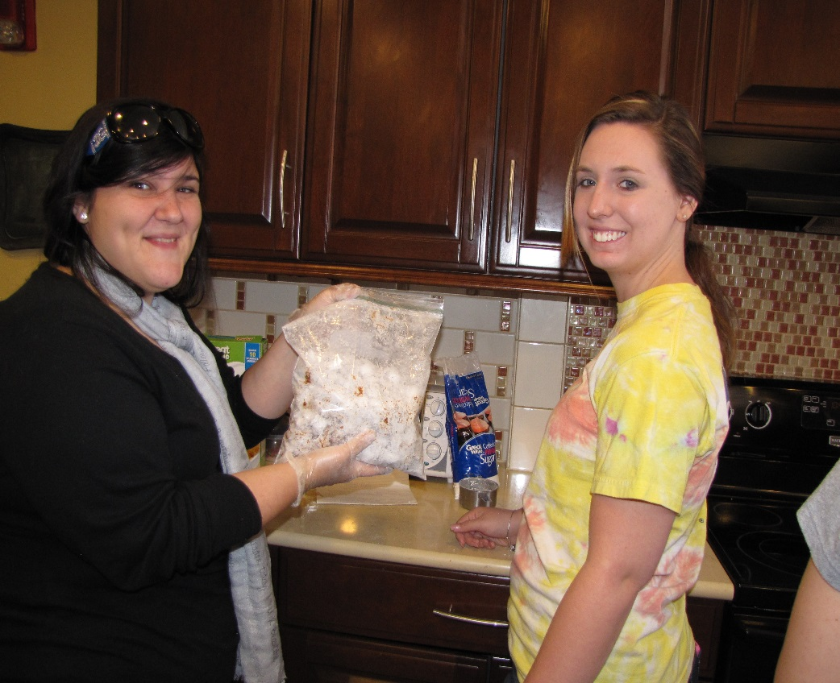
National Trio day
Service & Friendship
February 28, 2015

Slide 13
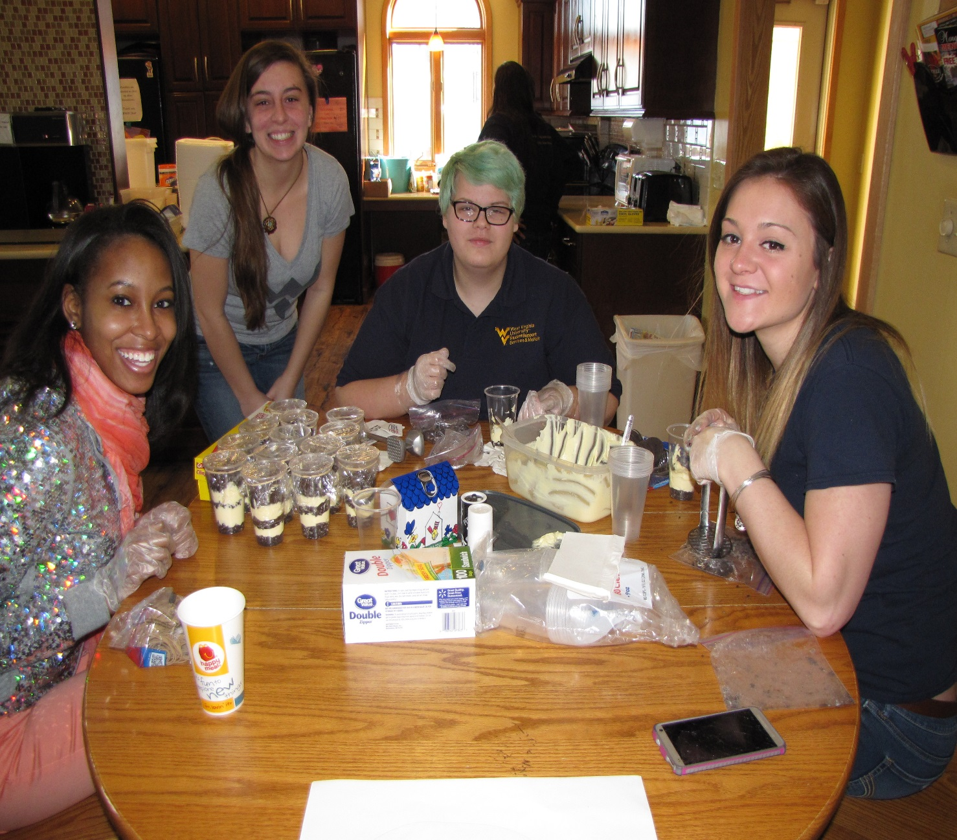
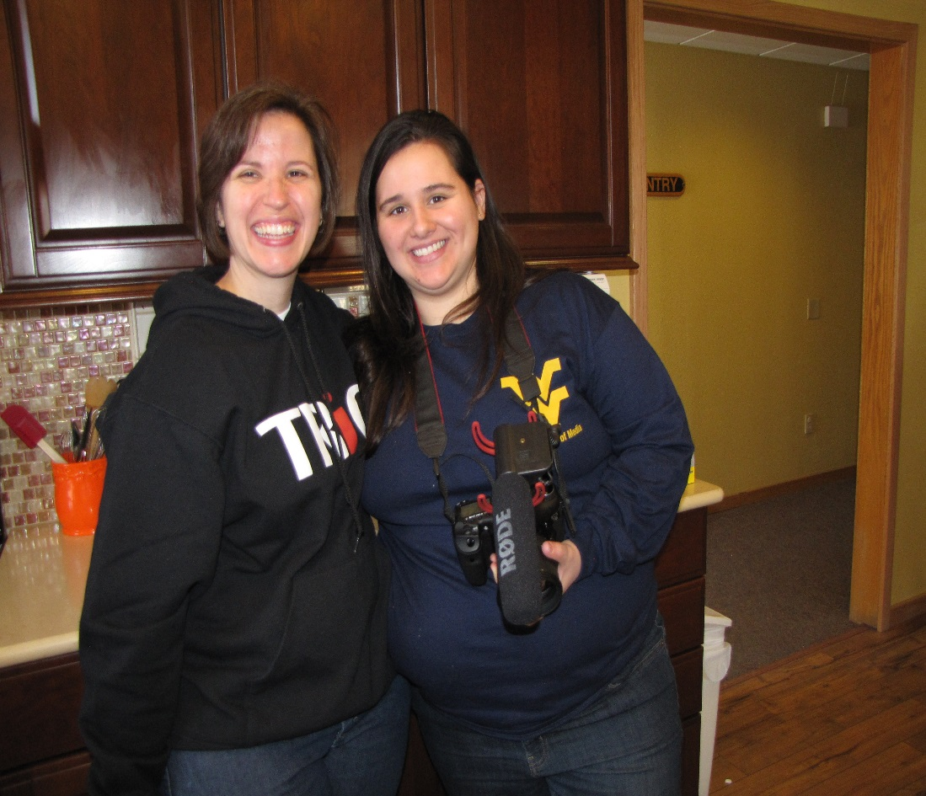

Slide 14
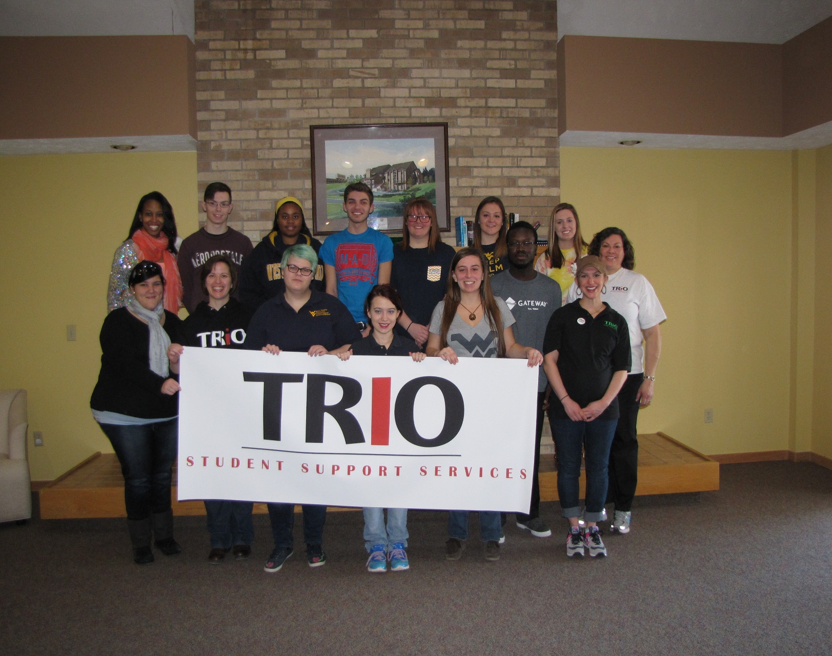

Slide 15
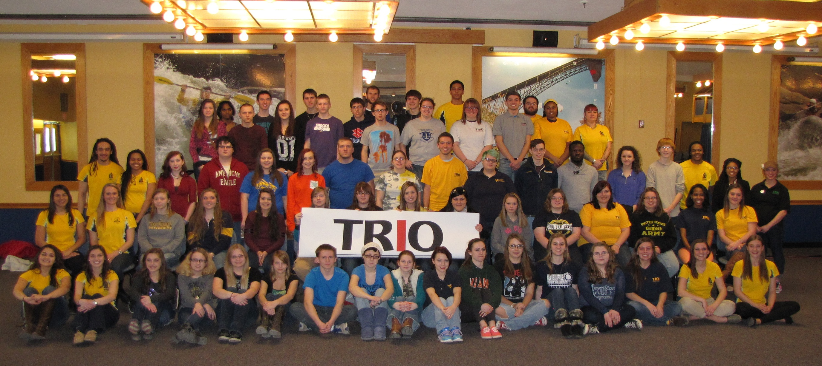

Slide 16
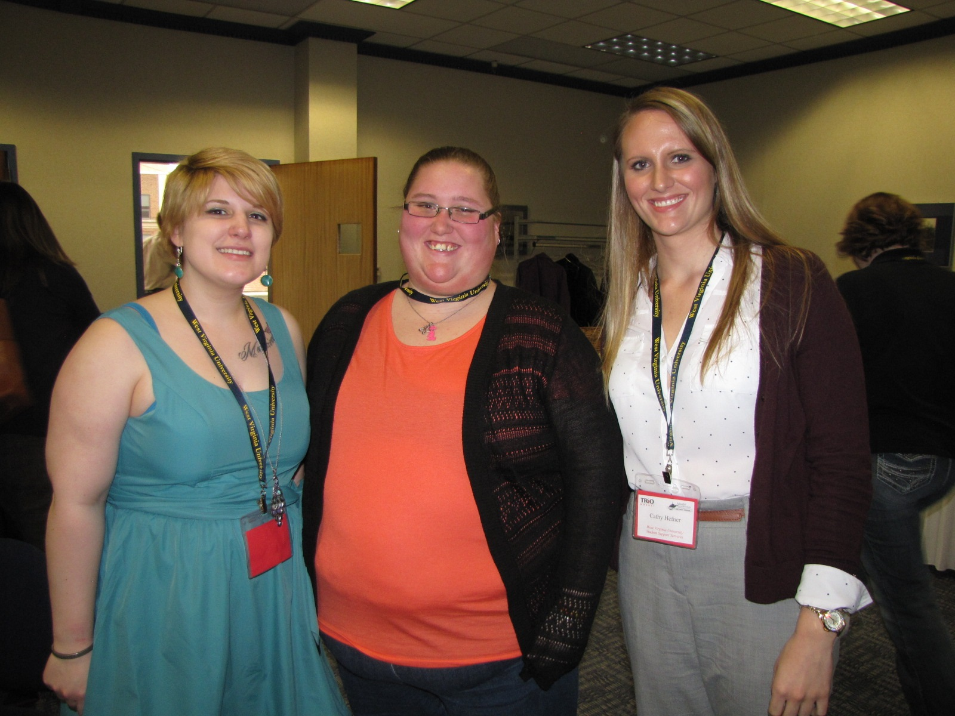
Student Leadership conference
West Virginia
TRiO
March 27, 2015

Slide 17
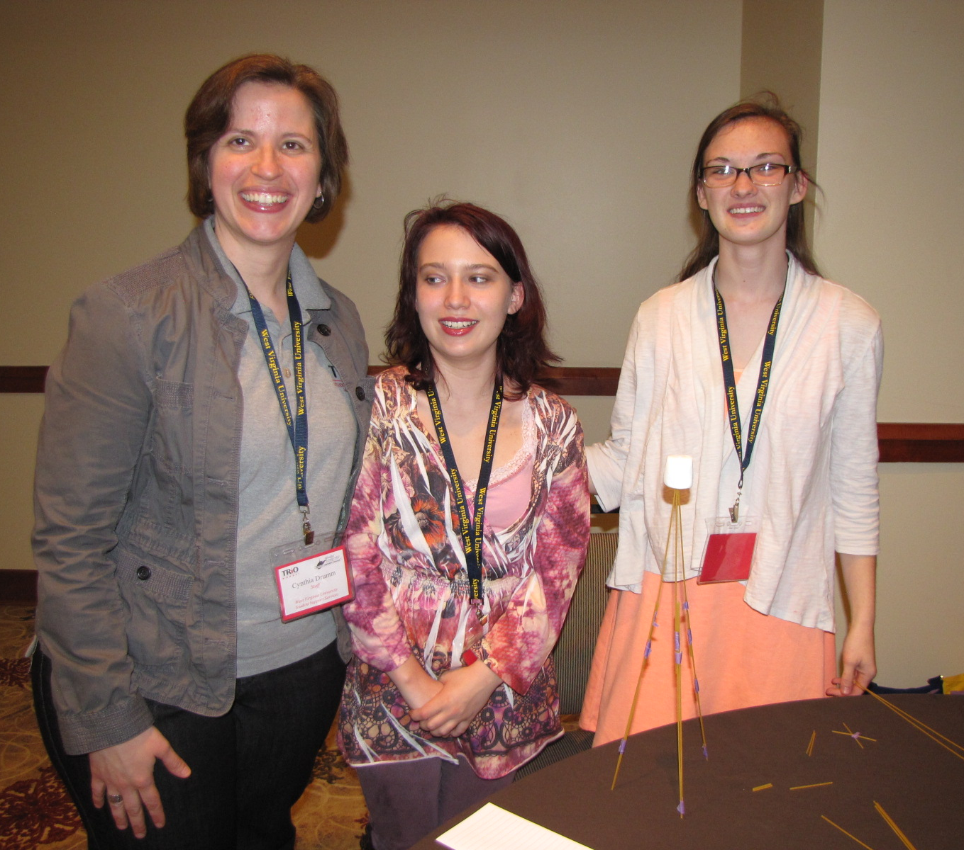
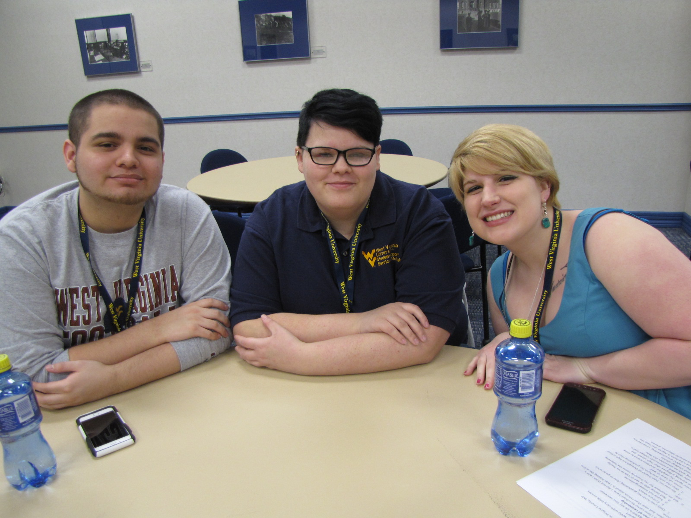
Leadership

Slide 18
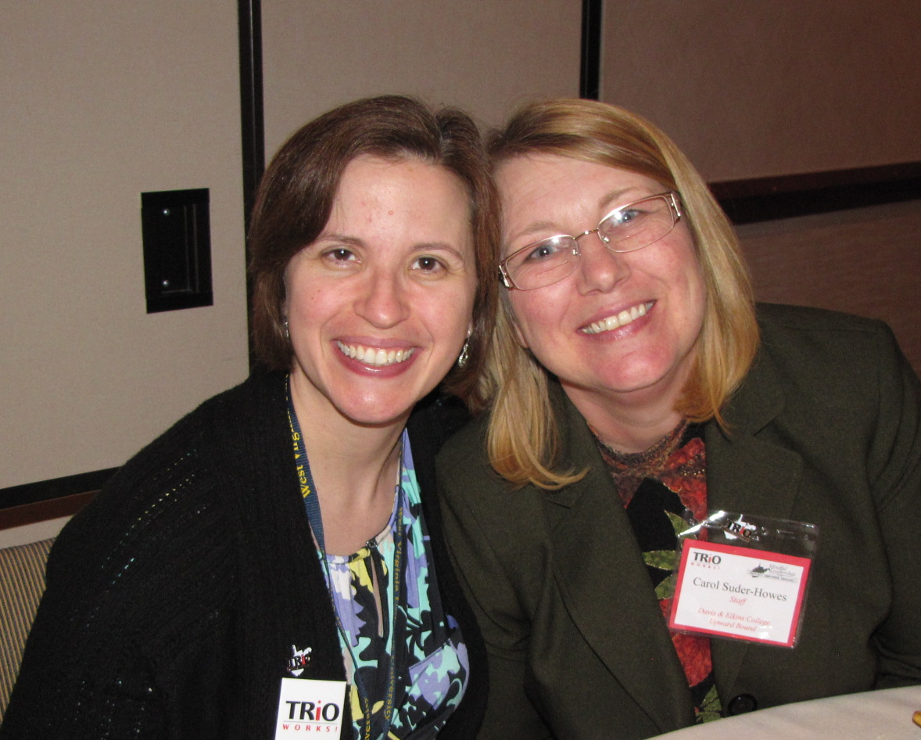

Slide 19
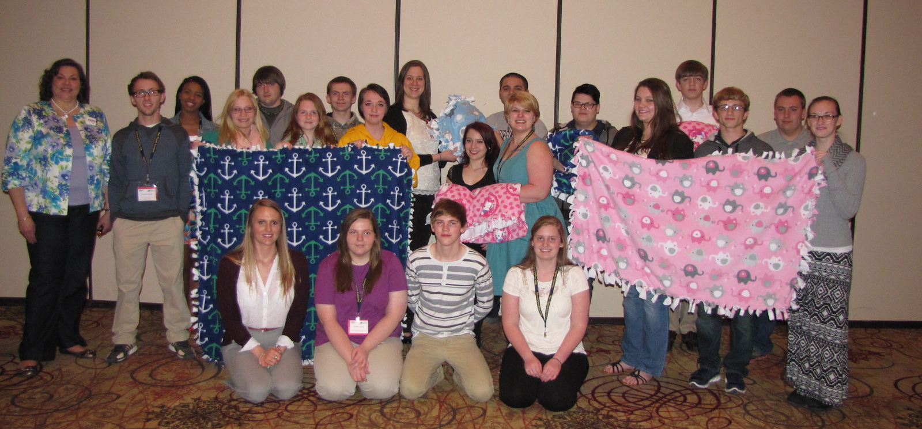

Slide 20
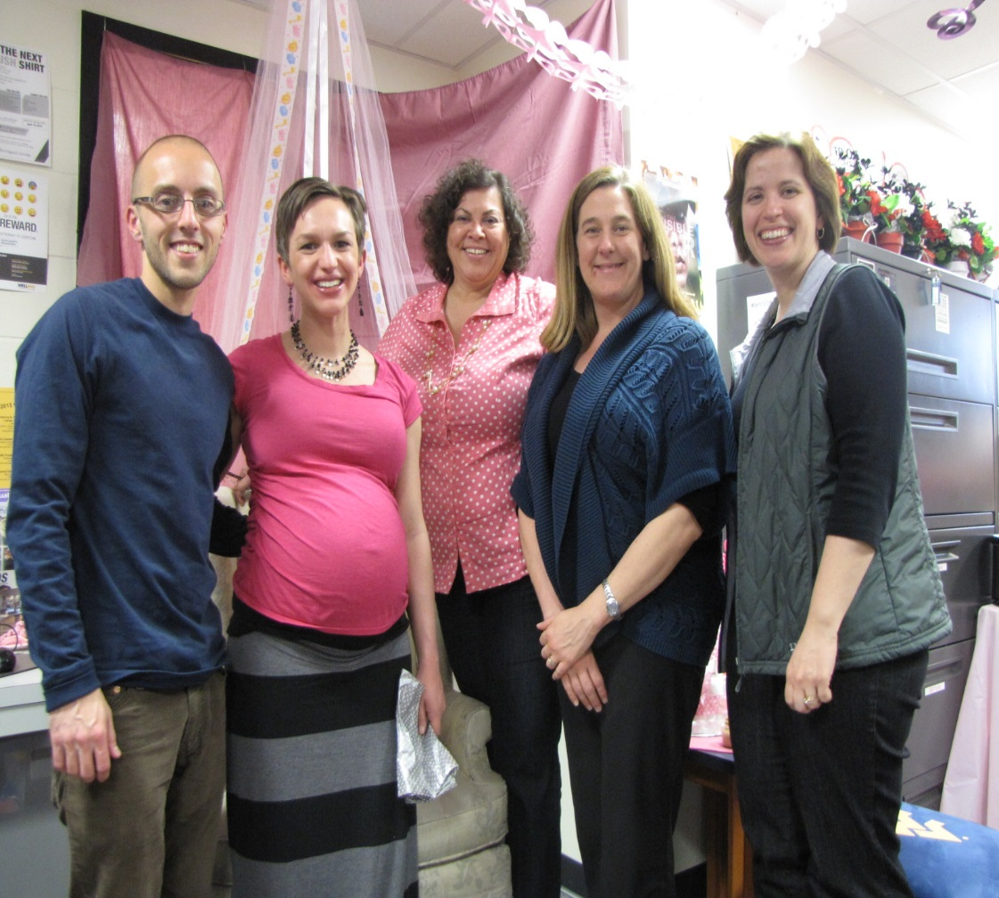
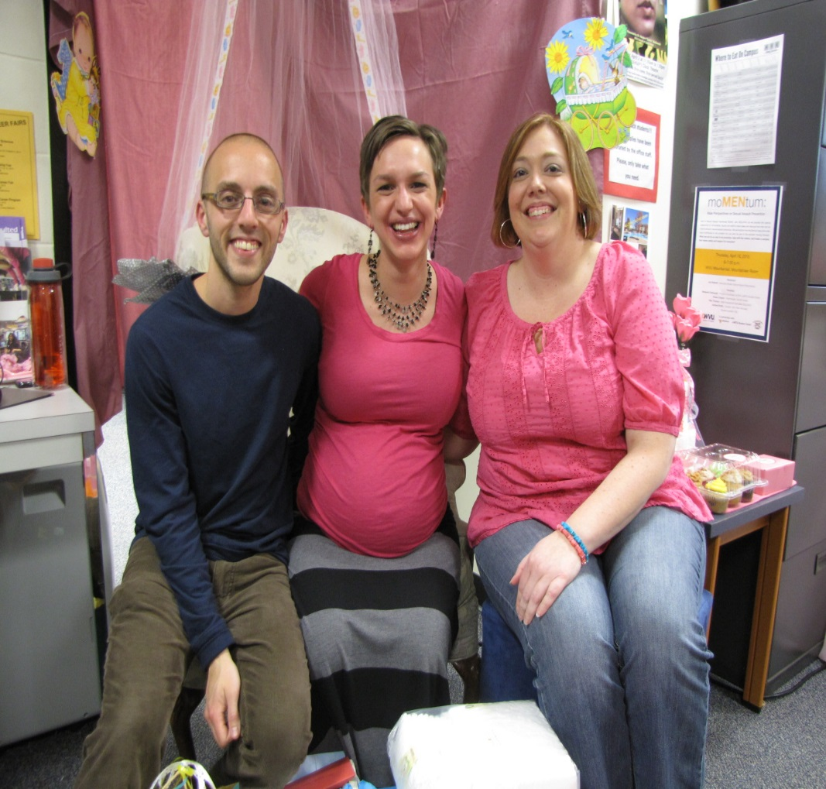
Hello baby 2.0

Slide 21
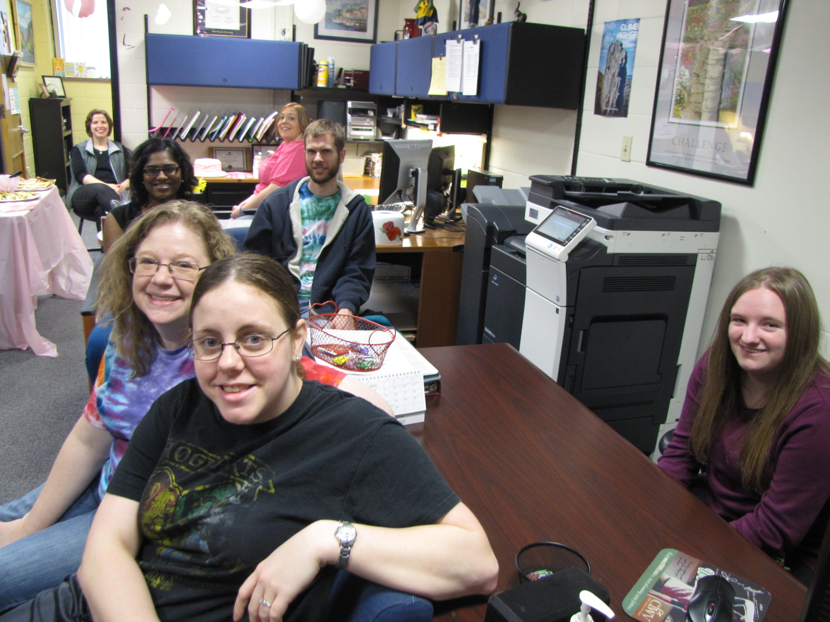
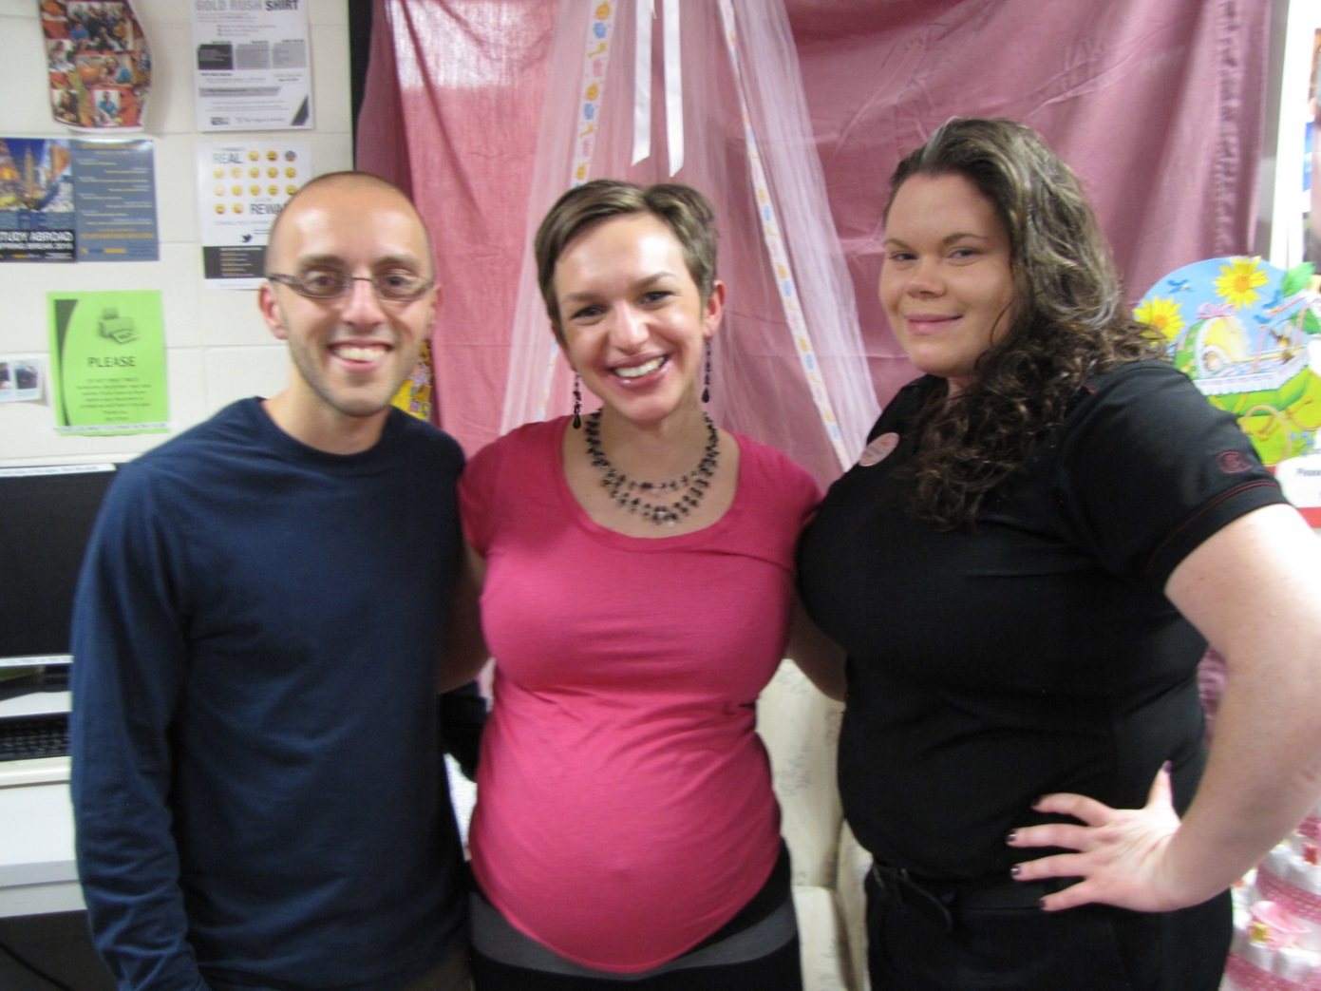

Slide 22
Welcome Clementine Rose
Born April 24th
7 pounds, 15 ounces

Slide 23
These students were awarded scholarships to attend the WV TRIO Student Leadership Conference in Morgantown, March 26th-27th, 2015
Adam Cruz
Vicki Cooper
Shelby Bradford
Katelyn Keener
Kimberly Barr
Catherine Hefner
Thank you for representing the SSS program at the conference – we are proud of you!

Slide 24
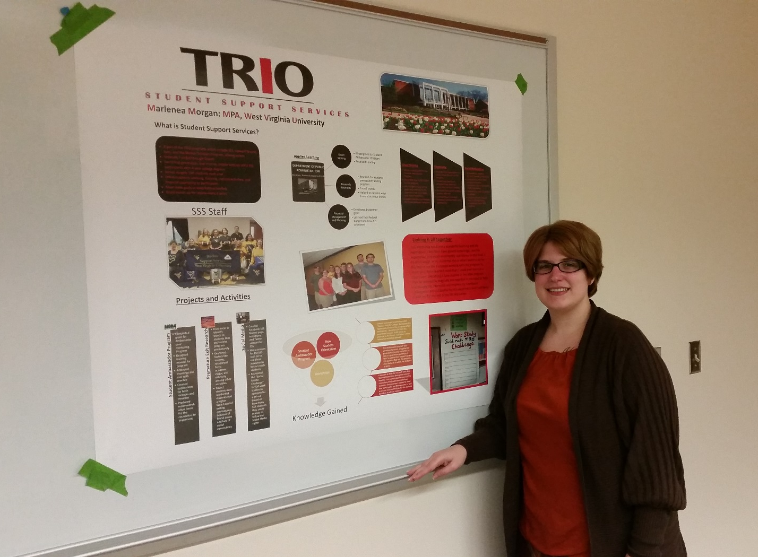
Congrats to Marlenea Morgan
This SSS alum interned with our office this year and will be graduating with a Master’s Degree in Public Administration this month!

Slide 25
Congrats to our Resident assistants!
Jazzmine Frasure
Gary Murray
Kaleb Ellison

Slide 26
Congrats to Edwin velasquez
For Starting the society of Hispanic professional engineers (SHPE)

Slide 27
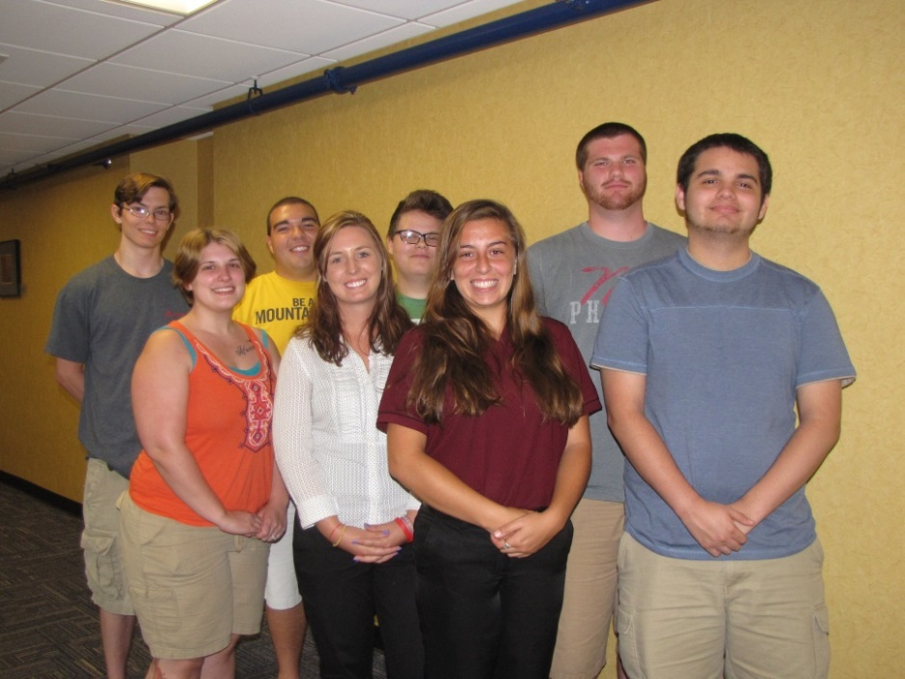
Founding members of SSS student ambassadors
Adam James
Nathan Hamons
Vicki Cooper
Ethan Marshall
Marlenea Morgan
Brittany Lockner
Jessica Soffee
Adam Cruz

Slide 28
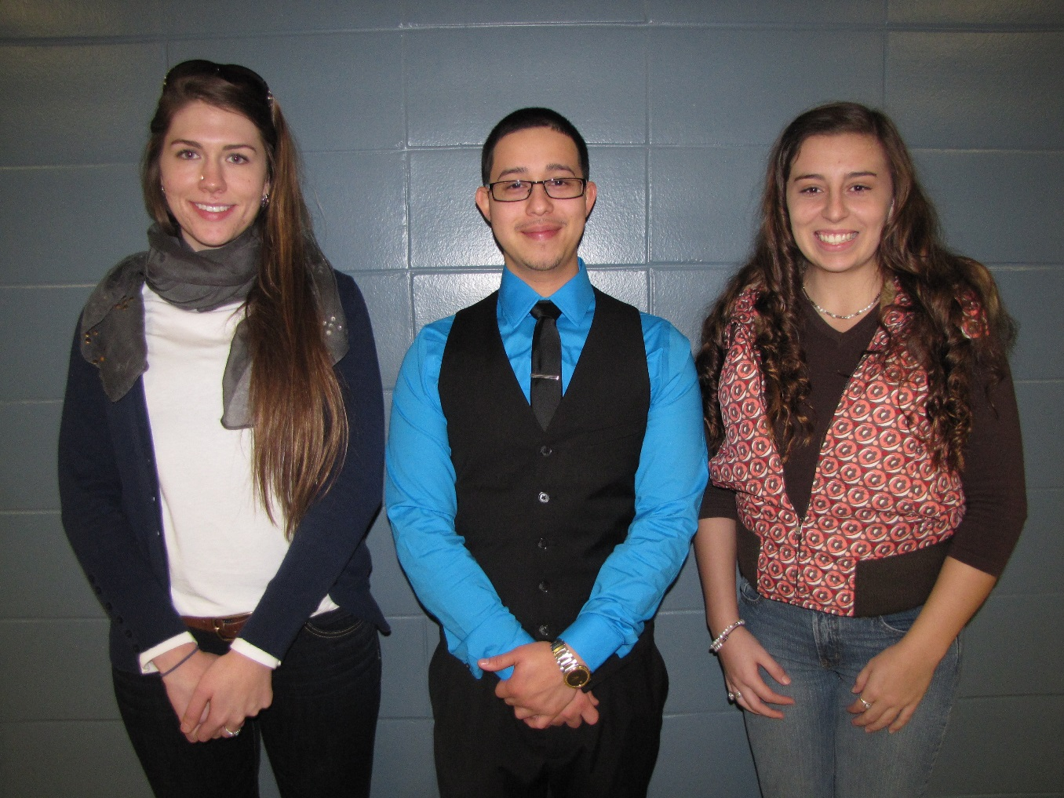
Congratulations to the 2014-15 SMyth family scholars
Megan Tenney
Edwin Velasquez
Jessica Soffee

Slide 29
Congratulations to the 2014-15 Suder scholars
Taylor Coleman
Jeanette Rupar
David Mersing
Myra dean
Bella shi
Adam Cruz
Josiah Roach
Oscar Lee

Slide 30
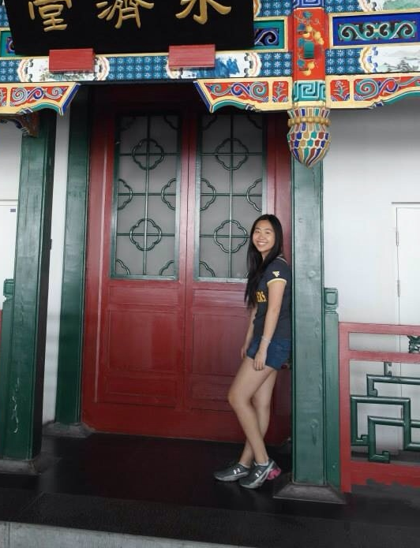
Congratulations to Elizabeth dang
2014-15 Gilman Scholar. Pictured on her 2014 Summer abroad trip to China.

Slide 31
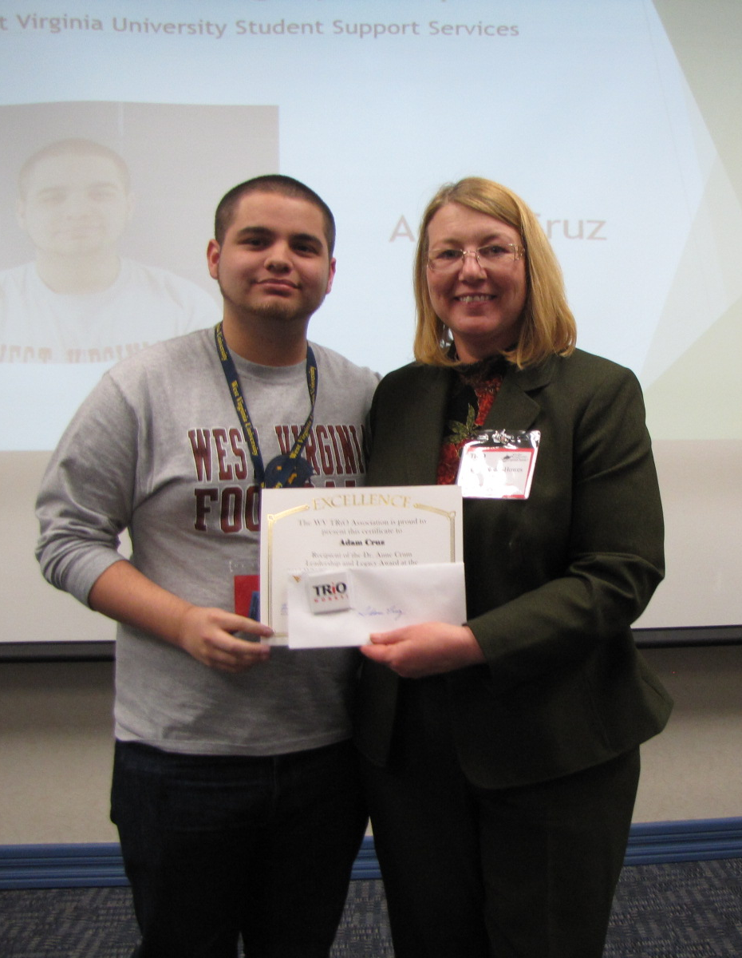
Congratulations to Adam cruz
2015 Anne Crum scholarship recipient at the WV Trio Student Leadership Conference

Slide 32
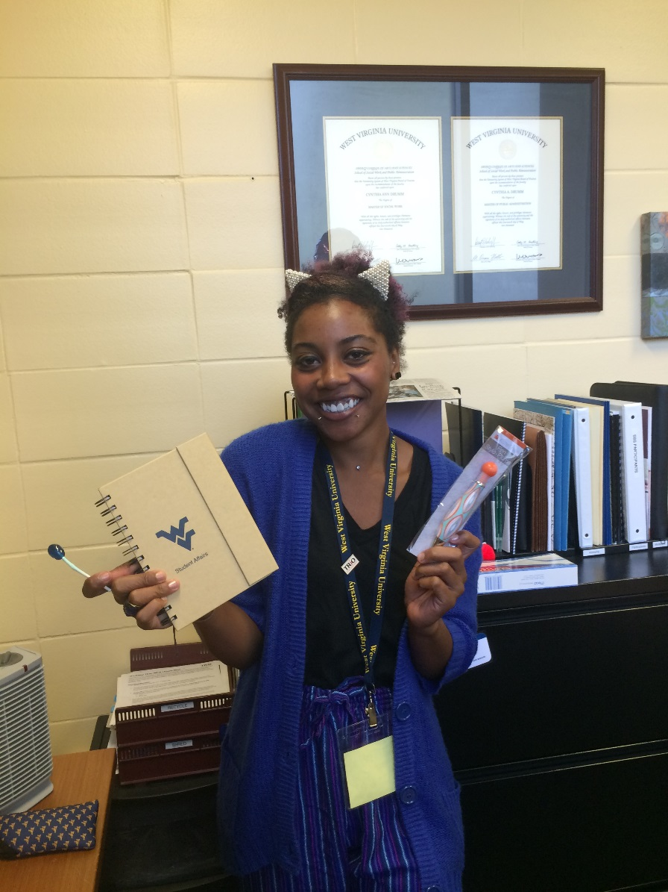
Taylor Coleman
E-weekly trivia contest winner

Slide 33
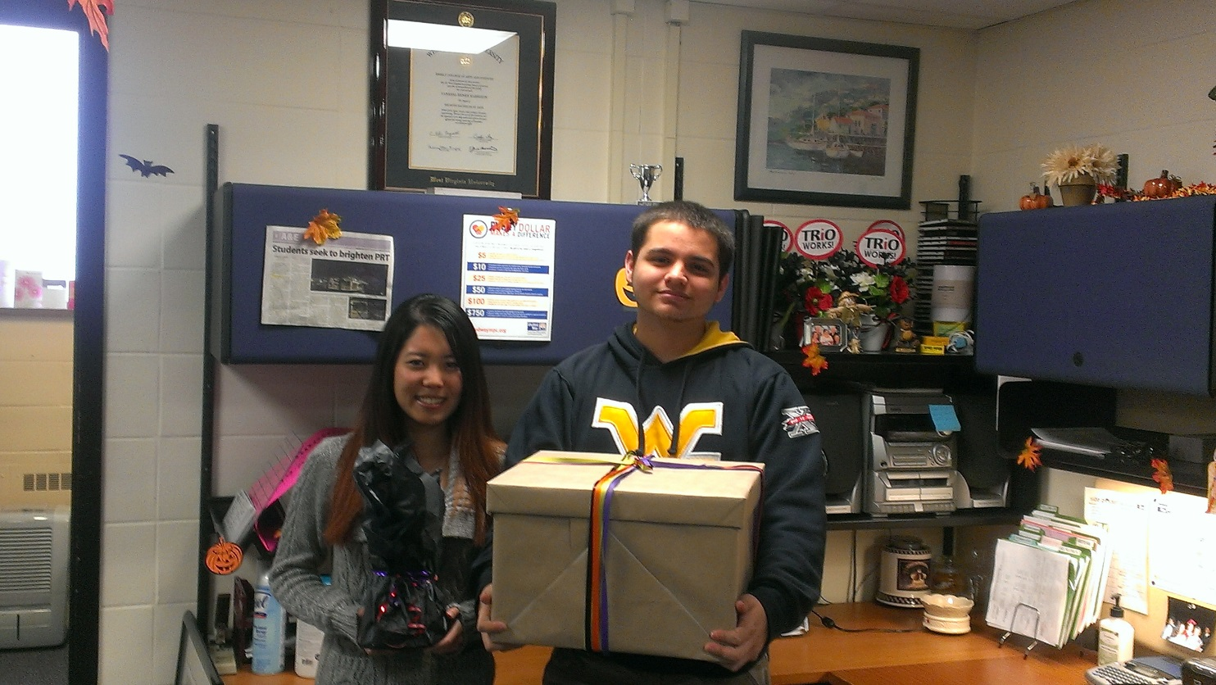
Congratulations to the winners of the social media challenge
Adam cruz (winner)
Bella shi
(2nd place)

Slide 34
Congratulations to ryan Simonds and cathy hefner
WV TRiO & MEAEopp scholarship nominees!

Slide 35
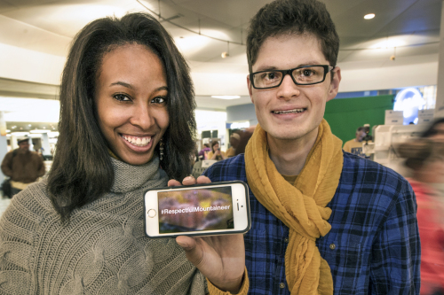
Congratulations to Deonna gandy
Co-founder of the #Respectful mountaineer campaign to combat negative images of wvu

Slide 36
Congratulations to the SSS staff!
honored at the 2014 Hispanic heritage celebration for contributions toward the success of Hispanic students at wvu

